Slide 1
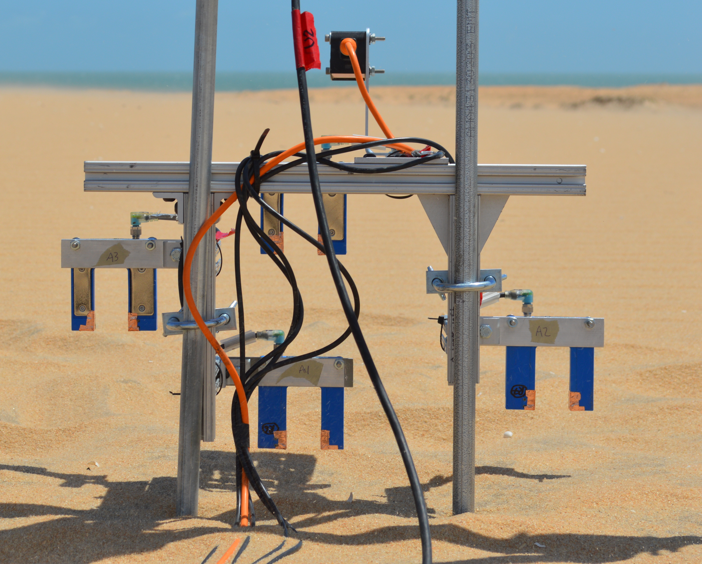



Wenglor geometry
distance sensor
$$z_{rel,i}$$
Wenglor
$$z_{dist}$$
$$z_{i}$$

